Slide 1
University Examination Management system
One stop solution for university EXAMINATION

Slide 2
STUdent Registration
Our technical team will analyze your existing system for Student Management.
After analysis we will make a dedicated module for student connection with our result process application.
This relation may be real time or bridge, depends upon analysis and management meeting.

Slide 3
Exam form
We will provide you facility to open exam form for different exam for students.
Form fee student can submit by bank gateway or we can generate an encryption safe challan for bank.
We are covering different exam
1. Main Exam
2. Back Exam
3. Special Back
4. Re-Check Form

Slide 4
Admit card
UMS will generate admit card and student can download admit card online.
We are implementing some security code on admit cards, that will help University to check that admit card is not fake.

Slide 5
Marks feeding
Exam department will generate code against exam copy code.
UMS will provide a panel to feed marks, here faculty can see generated code and can feed marks against them.
This is very much secure panel, secured by run time access code for registred faculty only.

Slide 6
Moderation and TR
After marks feeding we are providing moderation facility to make grading system result.
After moderation we can take printout for TR.

Slide 7
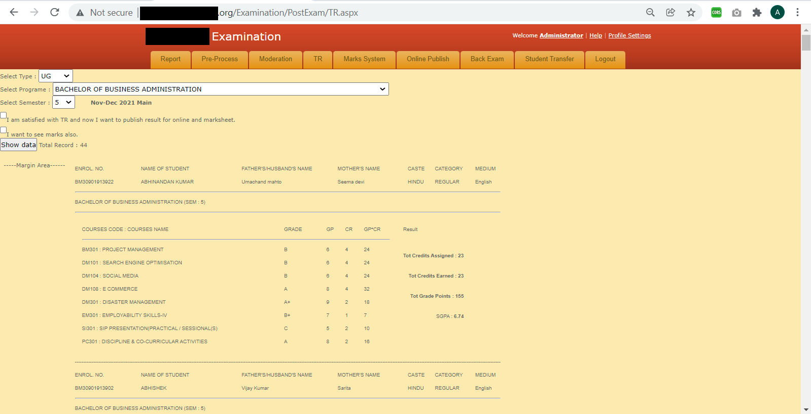

Slide 8
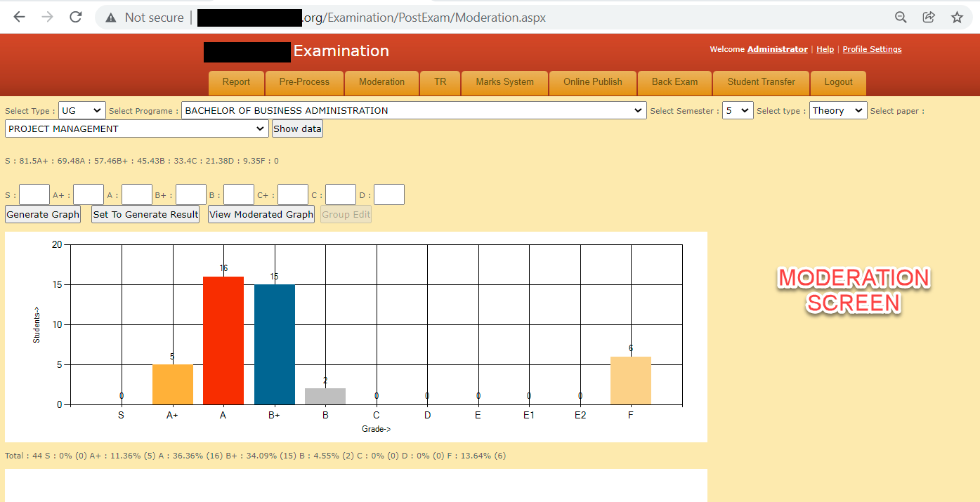

Slide 9
Result publish
We can publish result online for students.
Students can check result by enrollment number

Slide 10
Marksheet
We can generate marksheet with University approved format.
We can take printout of marksheet.

Slide 11
Backlog
UMS can calculate backlogs of student.
Students can fill back exam form as per backlog.

Slide 12
Certificate
UMS can generate provisional certificate.

